Slide 1
Finding an apartment in Wuppertal
IBM Certification

Slide 2
Problem to solve
The challenge to resolve is being able to find a rental apartment unit in Wuppertal (Germany). Therefore, the rental unit is subject to the following conditions:
- Apartment with min 1 bedroom
- Kitchen included
- Cold rent not to exceed 500€/month

Slide 3
Interest
This is a relevant project for anyone who is moving to a major city due to his job or anything else. The use of FourSquare data and mapping techniques combined with data analysis will help resolve the problem. Lastly, this project is a good practical case toward the development of Data Science skills.

Slide 4
Data Acquisition
In order to make a good choice of a similar apartment in Wuppertal (Germany), the following data is required:
Apartments for rent in Wuppertal area with descriptions (beds, price, location, address). For this research, We used the website: http://www.immobilienscout24.de/Suche/S-T/P-%s/%s-%s/%s/%s?pagerReporting=true
Information on neighborhoods in Wuppertal with their Geodata (latitude and longitude). The data has been found in this url: https://offenedaten-wuppertal.de/sites/default/files/Stadtbezirke_EPSG4326_JSON.json
Venues and amenities in Wuppertal neighborhoods due to FourSquare
Subway station of Wuppertal which you will find in this url: https://offenedaten-wuppertal.de/sites/default/files/Schwebebahnhoefe_EPSG4326_JSON.json

Slide 5
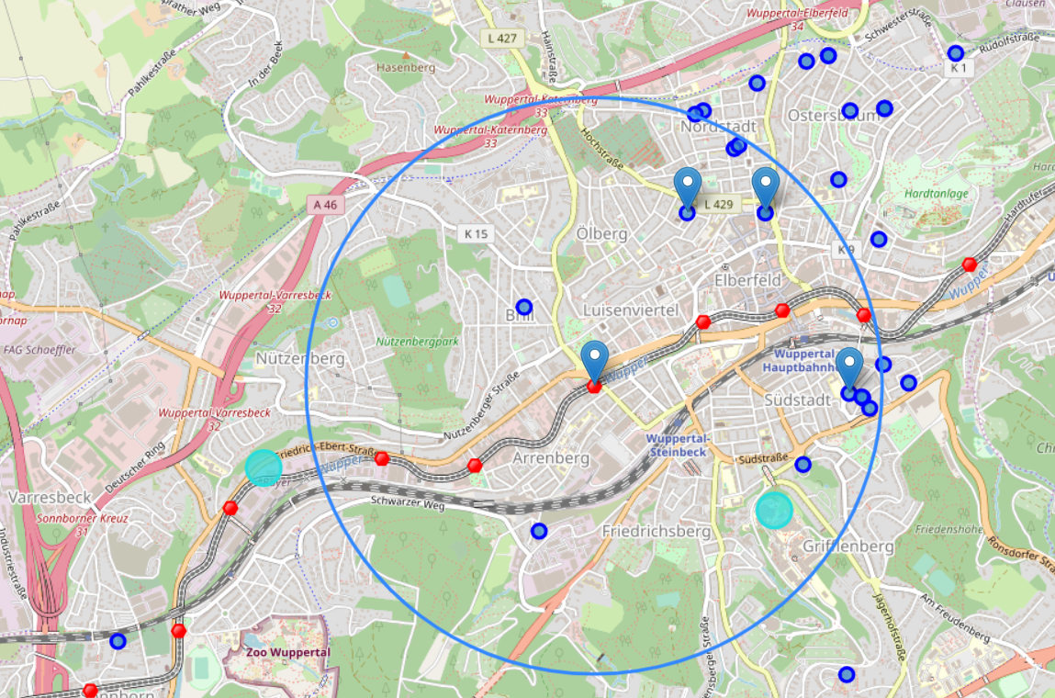
Pre selection of apartments

Slide 6
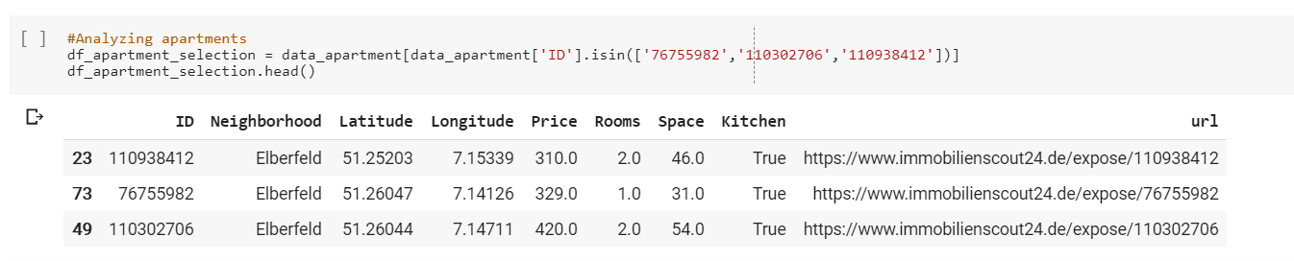
Final selection
Based on data analysis, I feel that the apartment at 420€/month seems to be a better choice since the extra monthly rent is worth the conveniences. In fact, it's close to my work. Furthermore, the apartment is bigger than the others which can be a good solution. In fact, I can rent the 2nd room which can help me to reduce the spends.

Slide 7
Conclusion
This course is a complete way to be able to master all the data science tools. In fact, I am grateful for the time and the efforts spent during these months.
However, I would like to thank all the people that help me online. Especially, “Gnavia007”.
See you in the next episode of the learning step 😊

